Slide 1
The role of scientific development for the development of country
Vohid Yusupovich Kholov

Slide 2

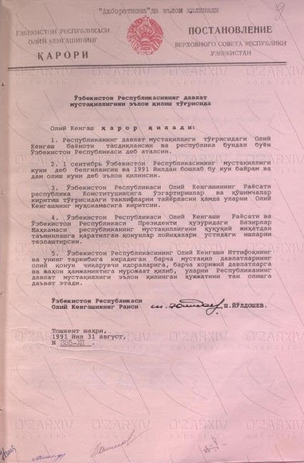
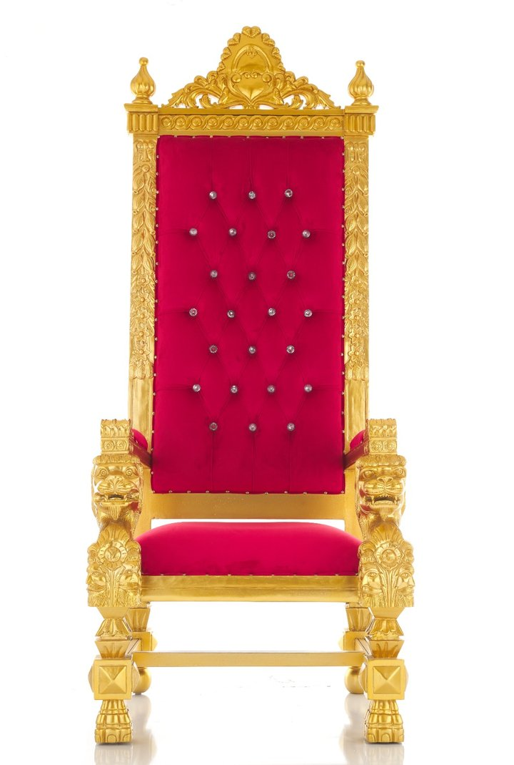

What sphere of History is this?

Slide 3



What sphere of History is this?

Slide 4

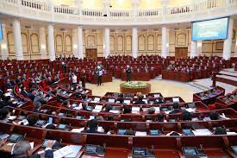


Slide 5
Nothing but advanced science, education and technology can make the country the most developed, competitive and reliable.
Vohid Kholov

Slide 6
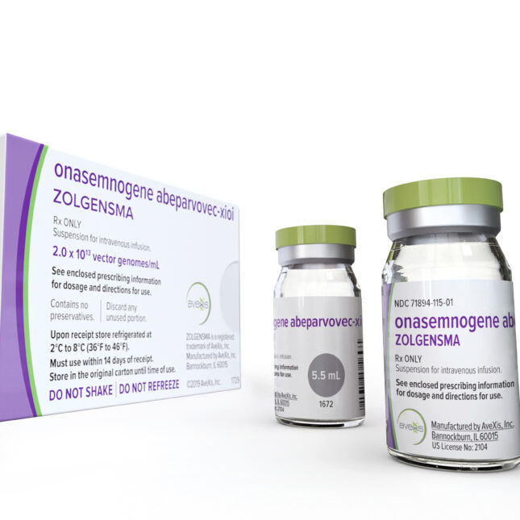
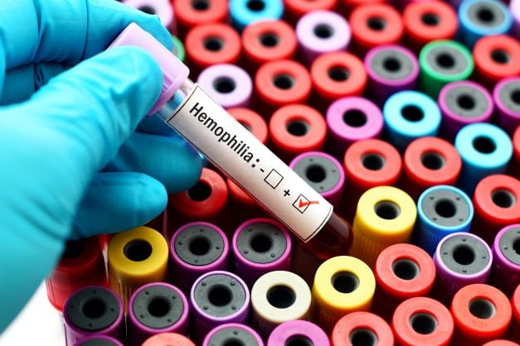
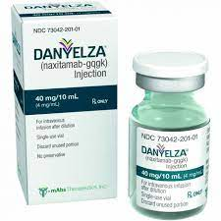
gene therapy;
to treat children less than 2 years old with spinal muscular atrophy (SMA).
high-risk neuroblastoma in the bone or bone marrow

Slide 7
Plan
Main factors of scientific development
The stages of scientific development in the territory of Uzbekistan
International practices analyses

Slide 8
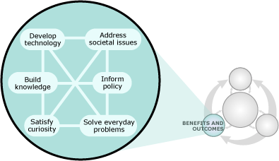

Slide 9
Main factors of scientific development
Migrations
State policy
Translation
Funding

Slide 10
Migrations
The land of Turkestan the crossroad of great migrations in history. It integrated Turkic, Iranian and Chinese nations being a bridge. There are two benefits of migrations in scientific development:
Bringing new skills, knowledge, experience, culture and their association with local ones. For example, in both renaissances of Central Asia, we see great migrations prior to them. The representatives of the first renaissance such as Khwarazmi, Ferghani, Biruni, Ibn Sina in exact and natural sciences, Bukhari, Motrudi, Termidhi, Zamakhshari and others in theology acquired the knowledge developed in the integration of many cultures.
When it comes to the period of Amir Temur and Temurids, scientific and architectural development was greatly influenced by migrations. In particular, Amir Temur brought best craftsmen, scholars and masters in many spheres from occupied territories. For example, best mathematicians of that period such as Qazizada Rumi (from Bursa, Turkey, Rum is the name of Turkey in eastern world), Jamshid Kashi (from Iran) are clear examples of it. Besides, there was introduced multi-colour decoration in interior and exterior of buildings, use of new types of materials, new styles that were a dominant architectural style in the area.
The other factor migration influence in migration is said to be connected with DNA soundness. It is noted that intermixture with different DNA form may increase the soundness of the nations.

Slide 11
State policy
It is known from history that mostly scientifically developed countries have led world orders, policy and economy. For instance, Alexandre Macedonian formed the first empire in Eurasia when Greek intellectual life was dominant in the world. Arabic caliphate had the strongest place in IX-XII centuries due to the developed scientific achievements. From the XVI century, in particular, the evolve of European renaissance, Europe became major power while it moved to the American continent in the second half of the XX century. It is mostly connected with scientific development results. Countries should not only support science, but care for scholars. In the last 6 years, hundreds of scholars working abroad returned to Uzbekistan.
Secondly, science gets developed when innovative ideas are promoted. In this perspective, state policy should promote freedom of innovative career. Scientific process must be developed and regulated by laws. On July 22, 2019, the law of Uzbekistan “On Science and scientific activity” was adopted. By then, the sphere had been regulated by different decisions, commands and resolutions. Besides, re-establishment of the Academy of Sciences, formation of the Ministry of Innovative development are state policy to support science.

Slide 12
Translation
In the development of science, translation of sources play a significant role. As is known, translation was a core of scientific development. For example, Latin and Greek sources were massively translated into Arabic and Persian in the sites of Arabic caliphate and they played a distinct role for the development of science. Coming to the XII century, there was established Toledo school of translation in Spain to translate books of Islamic works into Latin and spread them throughout Europe. Consequently, Europe possessed the translations of best scholar’s such as Ibn Sina, Biruni, Khwarazmi and etc.
The translation was kept in later centuries. Europe drew its attention to the translation of Oriental books. As an example, it can be said that one of the first works translated into English is the works of Abulghozi Bahadir Khan. They were translated into French in 1726, and into English in 1729 with a number of additions, and published in 1730. At the beginning of this translation, the translator made several interesting arguments and hypotheses. In particular, he notes that there was a high demand and thirst for knowledge in Central Asia in the Middle Ages, and he cites the astronomical table compiled by Tusi, the works written by Fazlullah (Rozbeh Khan) and the history of the Turkic and Mongolian peoples as examples. Also, during the period of Amir Temur, the development of science continued, Ulughbek made an astronomical table and built an observatory, he told the reader that it is not surprising to see the rulers as the authors of books in the east, and that the translated work was also written by the ruler. “Canons of Temur", "Boburnoma" and other works were also translated. In addition, regular translation of the works of Muslim representatives such as Seydi Ali Rais, Mir Izzatullah, and French and German researchers sent to Central Asia was launched. Henry Skrine noted that Mirzo Ulugbek's table of star positions is considered the most accurate and perfect among the tables going from east to west. It shows the time scale, the location of the planets and stars. The best Latin editions of Zij were prepared by Professor Greaves of Oxford between 1642 and 1648, and were reprinted in 1767. According to Frederick Starr's research, Thomas Hyde, an Arabic scholar at Oxford University, translated the work of Mirzo Ulugbek and published it in 1665 as "Tabulae long. ac lat. Stellarum fi kharum ex observatione Ulugh Beighi" In 1723, John Darby translated Sharafiddi Ali Yazdi's "Zafarnama" into English based on the 1722 translation by the French orientalist Petit de la Croix. American journalist V.E. Curtis noted that “Canons of Timur" was first translated into English in 1780 by Joseph White Lodian, a professor at Oxford University. According to Charles Stewart, in 1783 Oxford professor J. White published a Persian transliteration of this work and an English translation by William Davy. Ch. Based on the Persian translation of Abu Talib Husayni, Stewart translated this work into English and published it in 1830 under the name "Mulfuzat Temuri". Ibn Havqal's work translated by William Ousley in 1800, "Boburnoma" translated by William Erskine in 1826. As a result, it created a good condition for Europeans to know quite well about our history.

Slide 13
Funding
Funding is the other important factor to develop science in the country. It includes the organization of facilities, laboratories, holding conferences, publishing books, preparation of personnel, research trips and so on. One of the reasons of our 1-renaissance was high funding be authorities, creation of all facilities. In present days, the success of the companies is associated with their fundings. For example, Volkswagen’s annual allocation for research is estimated around 15 billion Euros. In 2022, the funding by state in Uzbekistan is over 1 trillion sums with the exception of private allocation. In the later year, there have been established funds to send Uzbekistan youth abroad for education at bachelor’s, Master’s and Doctoral degree by state means. For instance, El yurt umidi (https://eyuf.uz/site/view-page?id=120), the fund under the Ministry of Innovative development of Uzbekistan https://mininnovation.uz/opendata/category/pf-6247-son-farmonga-asosan-ochiq-malumotlar) are clear examples of it.
In order to support scholars, there is payrise in the amount of 30 % of their basic salary for PhD holders and 60 % for Doctor of Science.

Slide 14

Investment on science by countries (top 10)

Slide 15
The stages of scientific development in the territory of Uzbekistan
1st renaissance – IX-XII centuries
Period of Temurids
Pre-modern period development
Science in the XX century
Latest reforms

Slide 16
Role of scientific knowledge in development
Until recently economists considered land, labor and capital as the only important economic factors
Intellectual pursuits and knowledge were seen as unrelated to and without any utility for concrete things. It is now recognized that scientific knowledge is more essential for wealth creation of nations today than either capital or land
Unique property of knowledge
Physical resources like energy and materials are mostly depleted when utilized
On the other hand knowledge is inexhaustible
The more people have access to knowledge the more knowledge is produced

Slide 17

Research number (top 10)

Slide 18
Years | Fundamental research programs |  | Applied research programs |  | Innovative researches |  | Public scientific and technical programs
 | Number of projects | Number of participants | Number of projects | Number of participants | Number of projects | Number of participants | Number of projects | Number of participants
2005 | 310 | 2994 | 1180 | 8916 | 130 | 1296 | 1620 | 13206
2006 | 307 | 2986 | 1143 | 8774 | 128 | 1318 | 1578 | 13078
2007 | 417 | 3556 | 1140 | 8765 | 173 | 1376 | 1730 | 13697
2008 | 417 | 3560 | 1140 | 8738 | 174 | 1370 | 1731 | 13668
2009 | 417 | 3555 | 591 | 6935 | 199 | 1700 | 1207 | 12190
2010 | 415 | 3550 | 591 | 6910 | 221 | 1710 | 1227 | 12170
2011 | 415 | 3542 | 591 | 6898 | 210 | 1697 | 1216 | 12137
2012 | 435 | 2715 | 933 | 6838 | 352 | 2184 | 1720 | 11737
2013 | 433 | 2706 | 932 | 6900 | 348 | 2180 | 1713 | 11786
2014 | 431 | 2695 | 951 | 6955 | 360 | 2206 | 1742 | 11856
2015 | 430 | 2690 | 796 | 6980 | 349 | 2152 | 1575 | 11824

Slide 19
Years | Patents
 | Innovations | Models | IndustrIal models | Total
2004 | 178 | 24 | 88 | 290
2005 | 407 | 32 | 53 | 492
2006 | 272 | 35 | 72 | 379
2007 | 312 | 70 | 76 | 458
2008 | 288 | 105 | 67 | 460
2009 | 235 | 74 | 71 | 380
2010 | 192 | 78 | 91 | 361
2011 | 192 | 92 | 95 | 379
2012 | 175 | 97 | 110 | 382
2013 | 184 | 86 | 147 | 417
2014 | 106 | 115 | 89 | 313
2015 | 153 | 76 | 138 | 367
2016 | 166 | 103 | 91 | 360
2017 | 205 | 104 | 124 | 433
Total | 3065 | 1091 | 1312 | 5468
Percent | 56,0 | 20,0 | 24,0 | 100

